Slide 1

Evolution of global biodiversity
Petr Keil
Notes:
Hi, my name is Petr Keil and this is my project Biodiversity dynamics across a continuum of space, time, and their scales.

Slide 2
How biodiversity came to be?
Biodiversity through geological time
Notes:
I am qualified to deliver all this

Slide 3
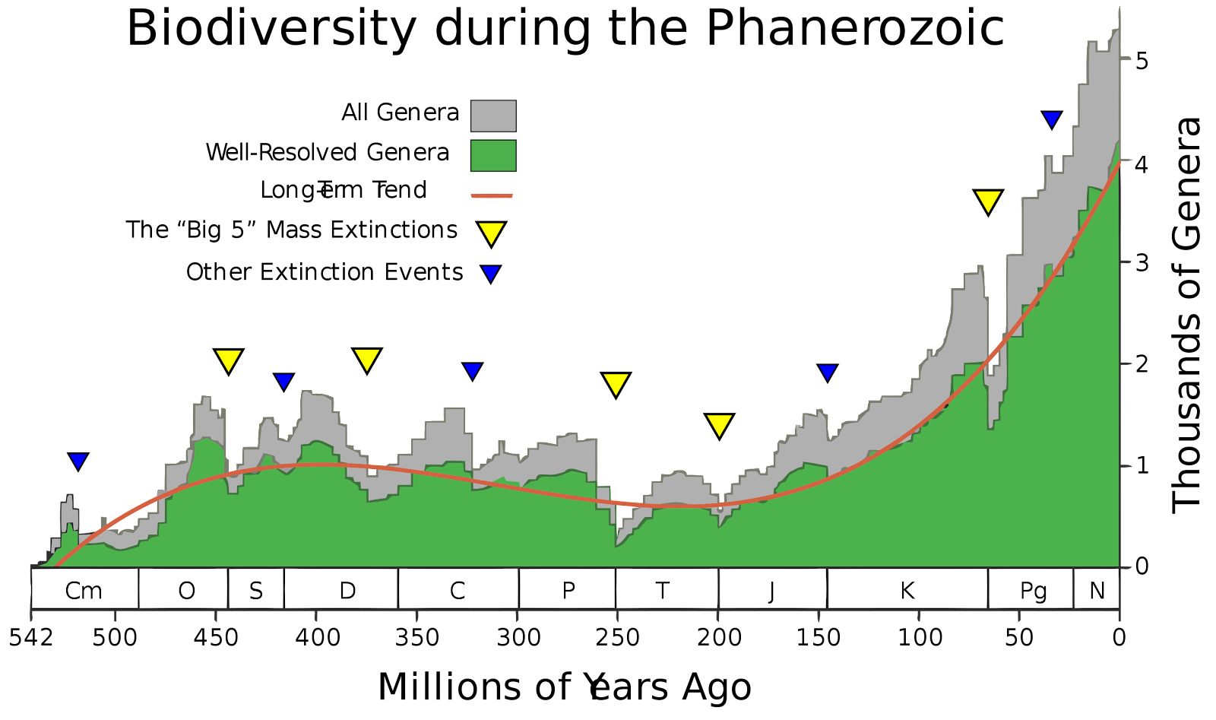
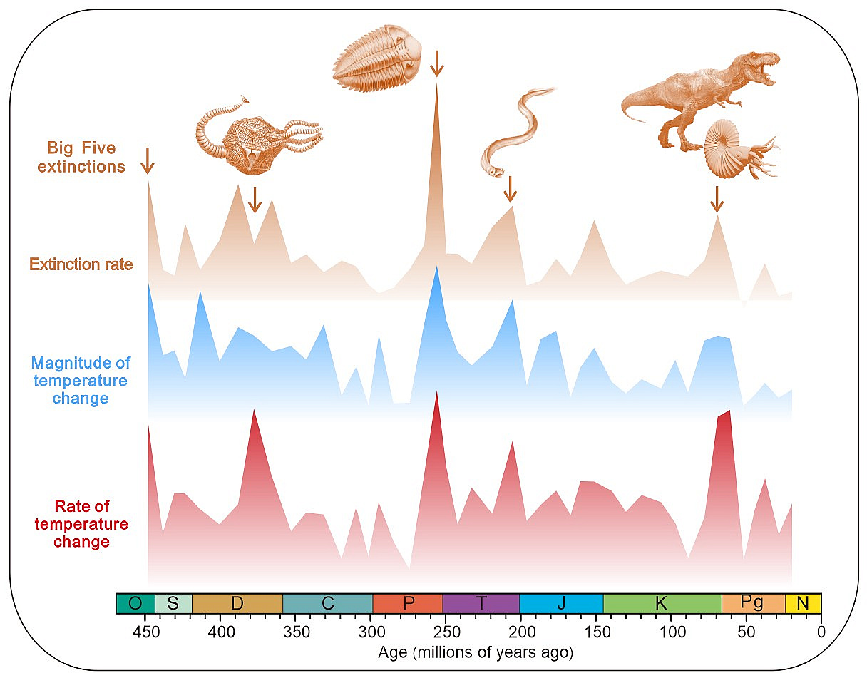
Biodiversity through geological time
Causes:
Giant volcanic eruptions
Asteroid impact
Sea level falls
Climate cooling/warming
Anoxia
Secret: Dinosaurs are still among us, they are just much smaller and have feathers
Notes:
In this panel we can probably all agree that biodiversity is one of the most valuable natural resources.
But things like climate change or habitat loss are a threat to biodiversity, to the extent that we hear about biodiversity crisis, or sixth mass extinction
For example, about 1% of vertebrate species have gone extinct because of humans

Slide 4
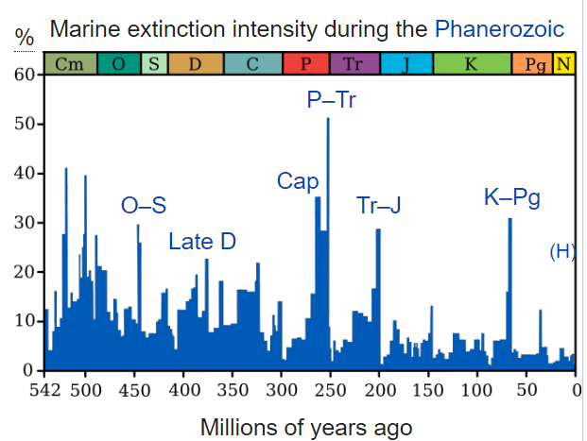
Magnitude of extinction events in % - background extinction rate
When both marine and terrestrial taxa considered, then it’s roughly 30-80% of extinct genera per big event
The usual background rate is ca 0.1-1 per million species-year (for fossilizing organisms)
Notes:
In this panel we can probably all agree that biodiversity is one of the most valuable natural resources.
But things like climate change or habitat loss are a threat to biodiversity, to the extent that we hear about biodiversity crisis, or sixth mass extinction
For example, about 1% of vertebrate species have gone extinct because of humans

Slide 5
The current extinction rate vs paleontological background rates
Díaz & Malhi (2022) Annu. Rev. Environ. Res.
Notes:
In this panel we can probably all agree that biodiversity is one of the most valuable natural resources.
But things like climate change or habitat loss are a threat to biodiversity, to the extent that we hear about biodiversity crisis, or sixth mass extinction
For example, about 1% of vertebrate species have gone extinct because of humans

Slide 6
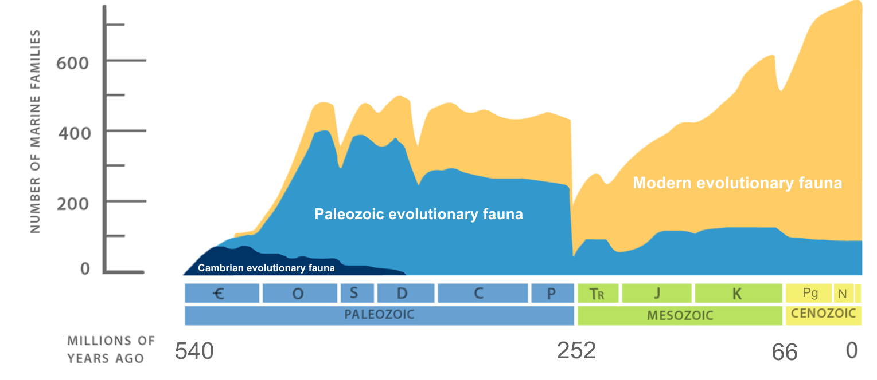
Increases of diversity after extinction events
Diversification = speciation – extinction
Radiation = rapid diversification from a small number of taxa
Notes:
In this panel we can probably all agree that biodiversity is one of the most valuable natural resources.
But things like climate change or habitat loss are a threat to biodiversity, to the extent that we hear about biodiversity crisis, or sixth mass extinction
For example, about 1% of vertebrate species have gone extinct because of humans

Slide 7
How new species emerge
Speciation and natural selection
Notes:
I am qualified to deliver all this

Slide 8
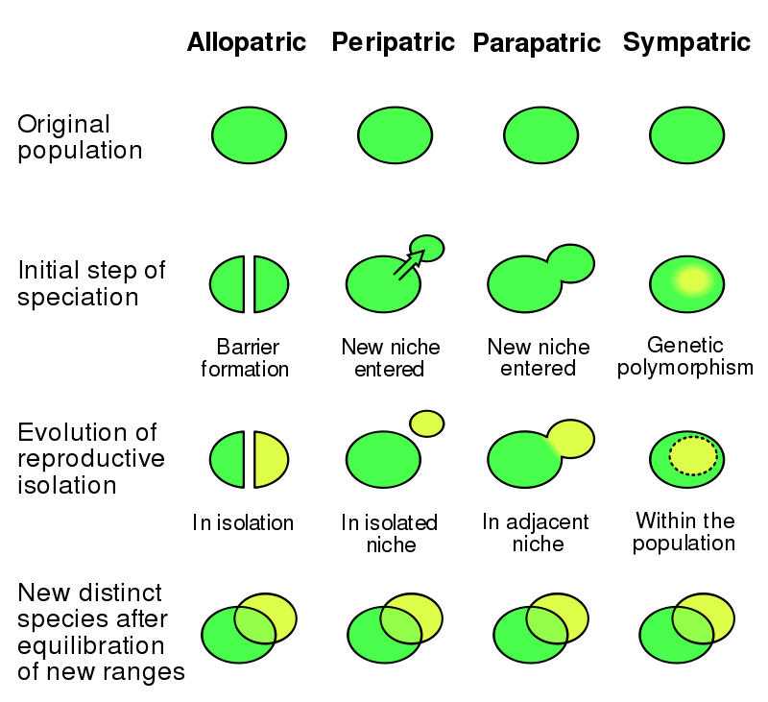
Speciation = how new species are created
This can only work when species change in time!
This happens through genetic drift (mutations), or adaptation to new environment
Notes:
In this panel we can probably all agree that biodiversity is one of the most valuable natural resources.
But things like climate change or habitat loss are a threat to biodiversity, to the extent that we hear about biodiversity crisis, or sixth mass extinction
For example, about 1% of vertebrate species have gone extinct because of humans

Slide 9
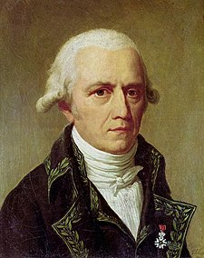
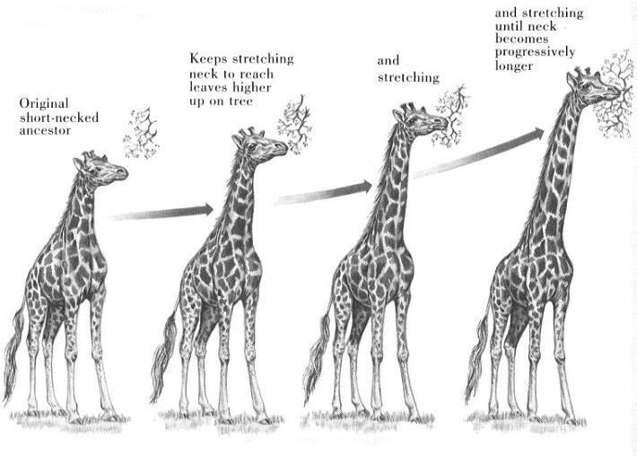
Species change, according to Lamarck
Jean Baptiste Lamarck (1744 – 1829)
Notes:
In this panel we can probably all agree that biodiversity is one of the most valuable natural resources.
But things like climate change or habitat loss are a threat to biodiversity, to the extent that we hear about biodiversity crisis, or sixth mass extinction
For example, about 1% of vertebrate species have gone extinct because of humans

Slide 10
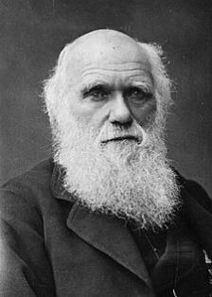
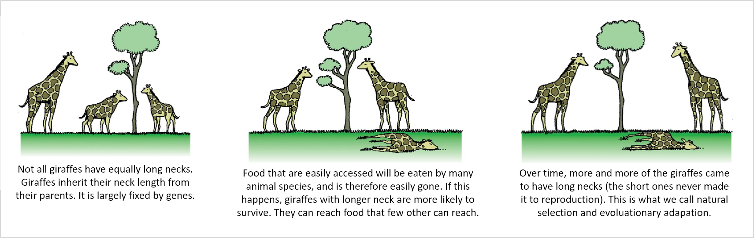
Species change, according to Darwin: natural selection
Natural selection is passive (the environment selects) and acts over generations, not during lifetime.
Darwin (1859) On the Origin of Species.
Notes:
In this panel we can probably all agree that biodiversity is one of the most valuable natural resources.
But things like climate change or habitat loss are a threat to biodiversity, to the extent that we hear about biodiversity crisis, or sixth mass extinction
For example, about 1% of vertebrate species have gone extinct because of humans

Slide 11
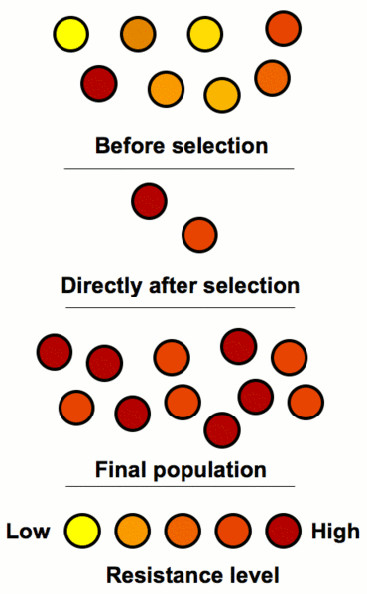
Adaptation
Adaptation
dynamic process of natural selection that fits organisms to their environment, enhancing their fitness.
state reached by the population during that process.
phenotypic trait or adaptive trait, with a functional role in each individual organism, that is maintained and has evolved through natural selection.
Organisms do not adapt during their lifetime, the merely reproduce and die
Notes:
In this panel we can probably all agree that biodiversity is one of the most valuable natural resources.
But things like climate change or habitat loss are a threat to biodiversity, to the extent that we hear about biodiversity crisis, or sixth mass extinction
For example, about 1% of vertebrate species have gone extinct because of humans

Slide 12
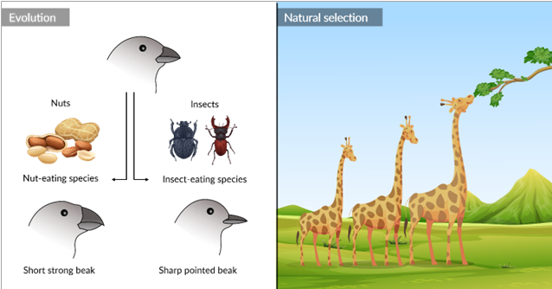
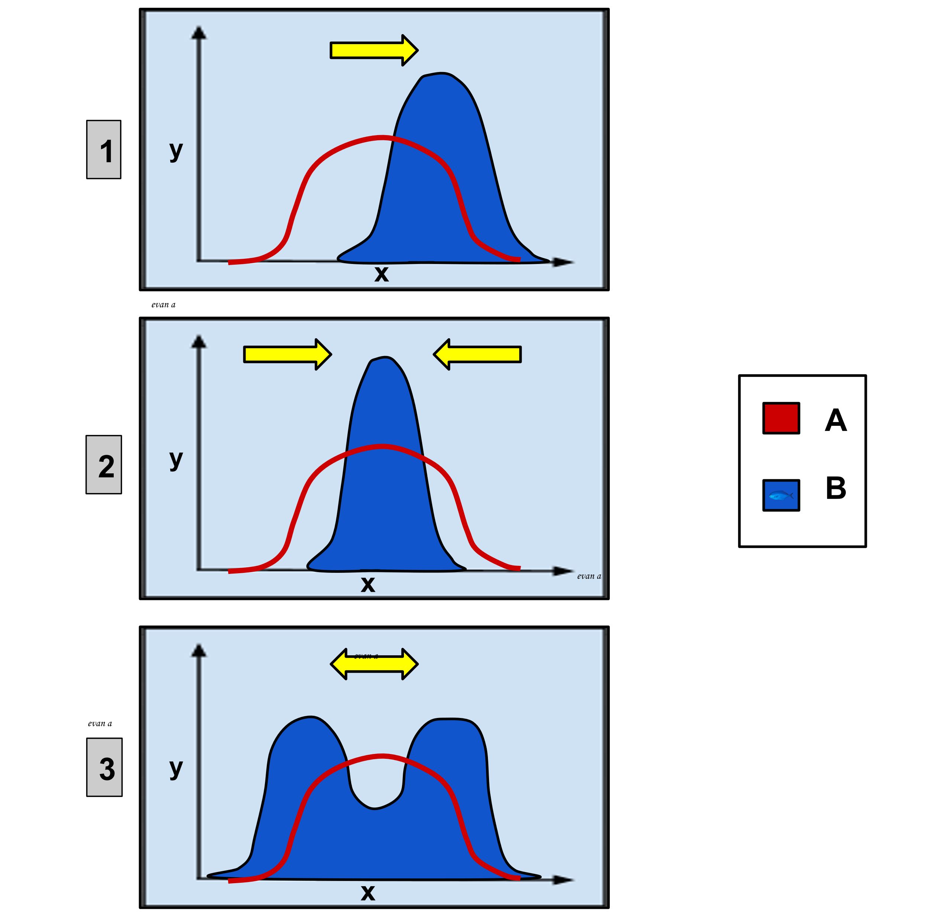
Types of selection
Lamarck’s giraffes
Directional selection
Stabilizing selection
Darwin’s finches
Disruptive selection
Notes:
In this panel we can probably all agree that biodiversity is one of the most valuable natural resources.
But things like climate change or habitat loss are a threat to biodiversity, to the extent that we hear about biodiversity crisis, or sixth mass extinction
For example, about 1% of vertebrate species have gone extinct because of humans

Slide 13
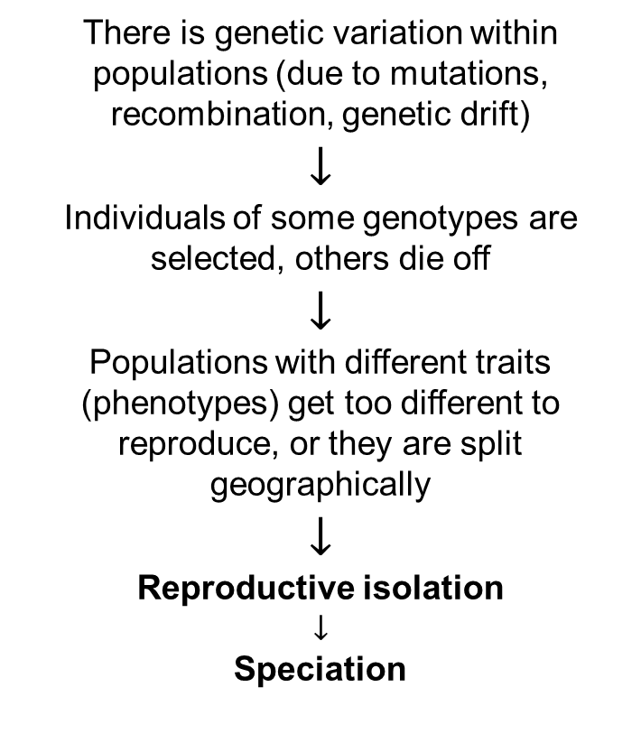
From natural selection to speciation
Lamarck’s giraffes
There is genetic variation within populations (due to mutations, recombination, genetic drift)
$$↓$$
Individuals of some genotypes are selected, others die off
$$↓$$
Populations with different traits (phenotypes) get too different to reproduce, or they are split geographically
$$↓$$
Reproductive isolation
$$↓$$
Speciation
Notes:
In this panel we can probably all agree that biodiversity is one of the most valuable natural resources.
But things like climate change or habitat loss are a threat to biodiversity, to the extent that we hear about biodiversity crisis, or sixth mass extinction
For example, about 1% of vertebrate species have gone extinct because of humans

Slide 14
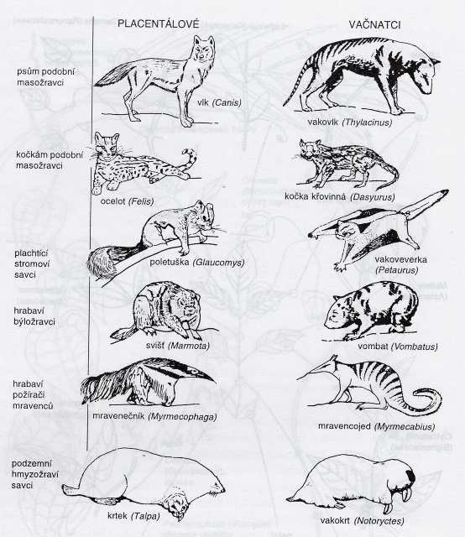
What supports this idea of evolution?
Hierarchical structure of similarity in nature.
The existence of homologies and parallel evolution
Fossils.
Imprints in embryonal development.
Imperfect nature of some traits.
Non-random distribution of organisms.
We can observe it in action right now.
It can also be re-created by humans, either experimentally (on drosophillas, bacteria, …), or by breeding
Notes:
In this panel we can probably all agree that biodiversity is one of the most valuable natural resources.
But things like climate change or habitat loss are a threat to biodiversity, to the extent that we hear about biodiversity crisis, or sixth mass extinction
For example, about 1% of vertebrate species have gone extinct because of humans

Slide 15
Phylogeny
The genealogy of species
Notes:
I am qualified to deliver all this

Slide 16

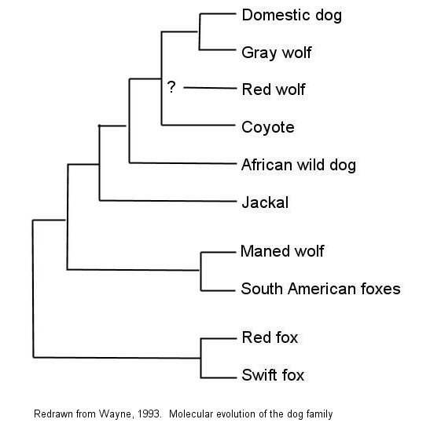
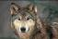
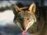
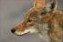
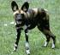
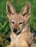
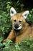
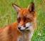
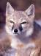
Phylogeny – the tree of life
Canid phylogeny:
Taxonomie – hierarchická klasifikace organismů
Fylogeneze – kmenový vývoj organismů v historickém (evolučním) sledu
Anageneze (neboli mikroevoluce) – evoluční změny uvnitř druhu
Speciace (neboli makroevoluce neboli kladogeneze) – štěpení linií v samostatné druhy
Notes:
In this panel we can probably all agree that biodiversity is one of the most valuable natural resources.
But things like climate change or habitat loss are a threat to biodiversity, to the extent that we hear about biodiversity crisis, or sixth mass extinction
For example, about 1% of vertebrate species have gone extinct because of humans

Slide 17
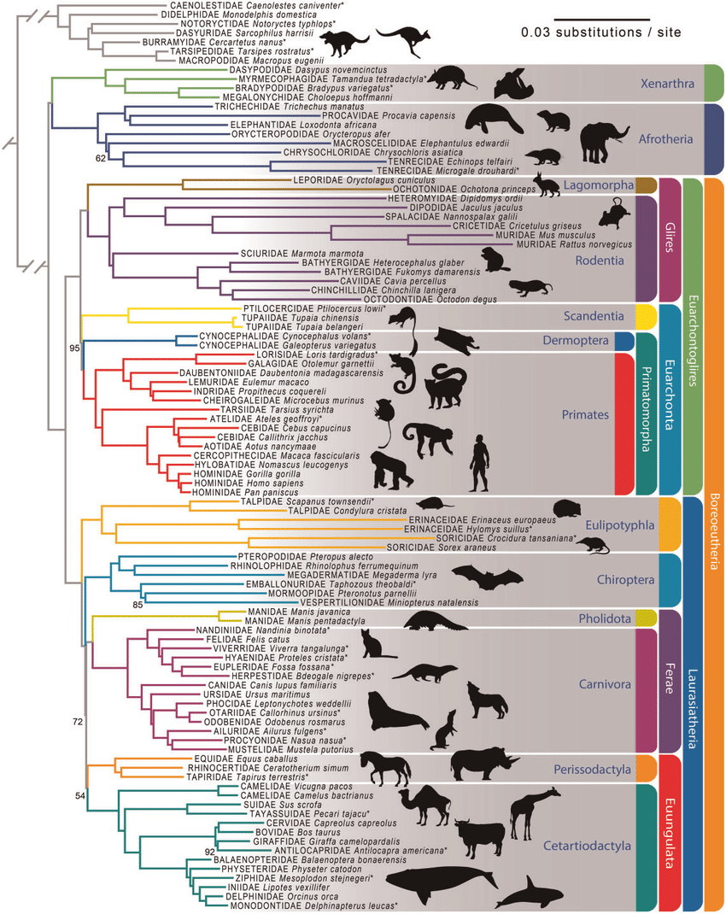
Phylogeny – the tree of life
Esselstyn et al. (2017) GBE
Notes:
In this panel we can probably all agree that biodiversity is one of the most valuable natural resources.
But things like climate change or habitat loss are a threat to biodiversity, to the extent that we hear about biodiversity crisis, or sixth mass extinction
For example, about 1% of vertebrate species have gone extinct because of humans

Slide 18
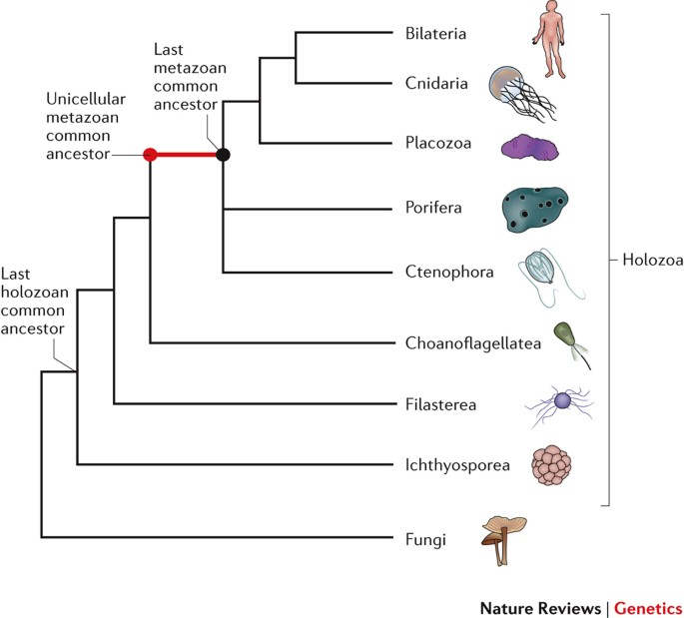
Phylogeny – the tree of life
Notes:
In this panel we can probably all agree that biodiversity is one of the most valuable natural resources.
But things like climate change or habitat loss are a threat to biodiversity, to the extent that we hear about biodiversity crisis, or sixth mass extinction
For example, about 1% of vertebrate species have gone extinct because of humans

Slide 19
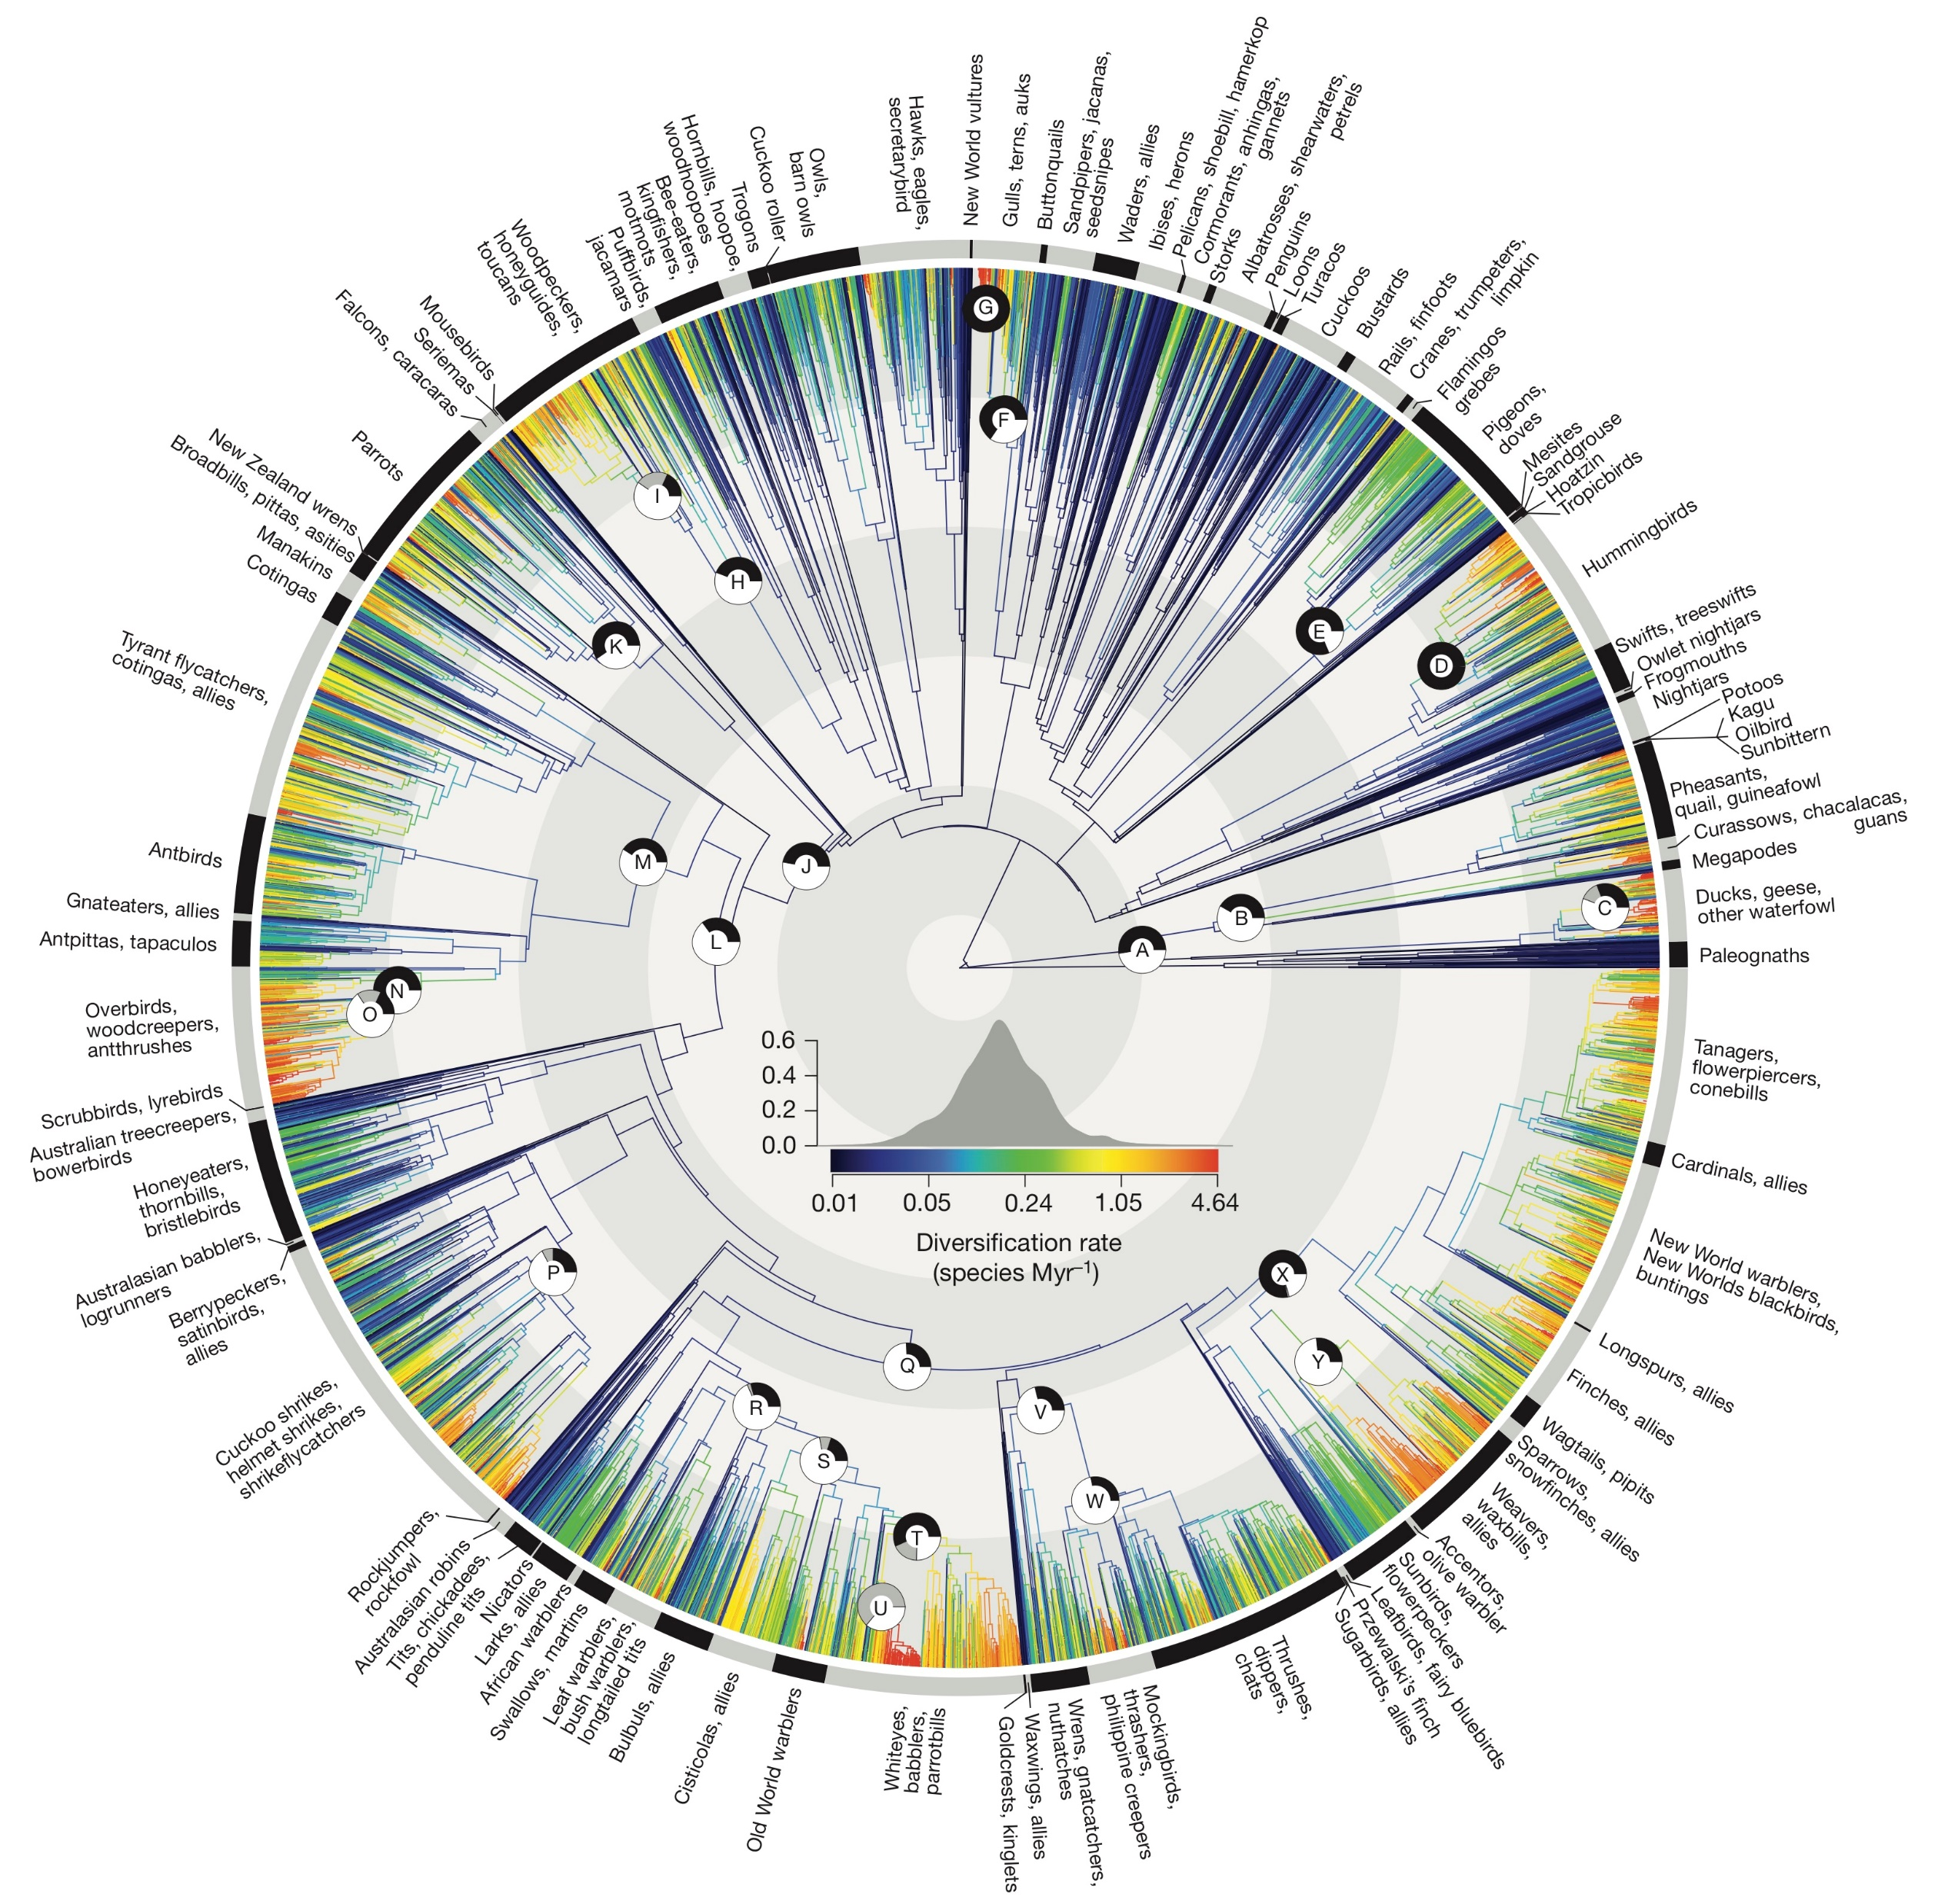
Phylogeny – the tree of life
Jetz et al. (2012) Nature
Notes:
In this panel we can probably all agree that biodiversity is one of the most valuable natural resources.
But things like climate change or habitat loss are a threat to biodiversity, to the extent that we hear about biodiversity crisis, or sixth mass extinction
For example, about 1% of vertebrate species have gone extinct because of humans

Slide 20
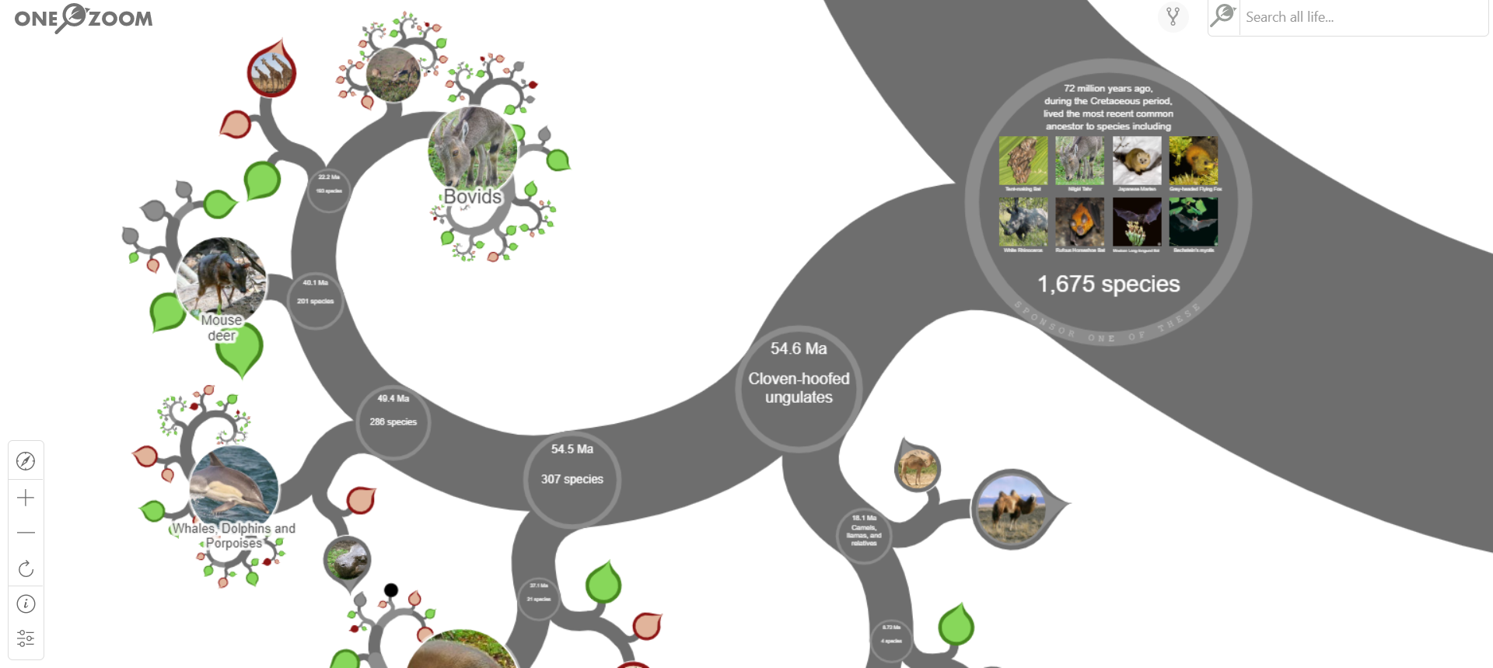
Phylogeny – the tree of life
https://www.onezoom.org/
Notes:
In this panel we can probably all agree that biodiversity is one of the most valuable natural resources.
But things like climate change or habitat loss are a threat to biodiversity, to the extent that we hear about biodiversity crisis, or sixth mass extinction
For example, about 1% of vertebrate species have gone extinct because of humans

Slide 21
What you should remember
The number of taxa steadily increased through geological time
There have been 5 major extinction events (the “big five”) and we are likely in the midst of another one
Apart from extinction, the other process generating biodiversity is speciation
You should know the principle of Darwinian natural selection, and how it’s connected to speciation
Evolutionary relationships among organisms are represented by a phylogeny a.k.a. phylogenetic tree
Notes:
In this panel we can probably all agree that biodiversity is one of the most valuable natural resources.
But things like climate change or habitat loss are a threat to biodiversity, to the extent that we hear about biodiversity crisis, or sixth mass extinction
For example, about 1% of vertebrate species have gone extinct because of humans

Slide 22
How much biodiversity is now on Earth
The creator has an inordinate fondness of beetles (Charles Darwin)
Notes:
I am qualified to deliver all this

Slide 23
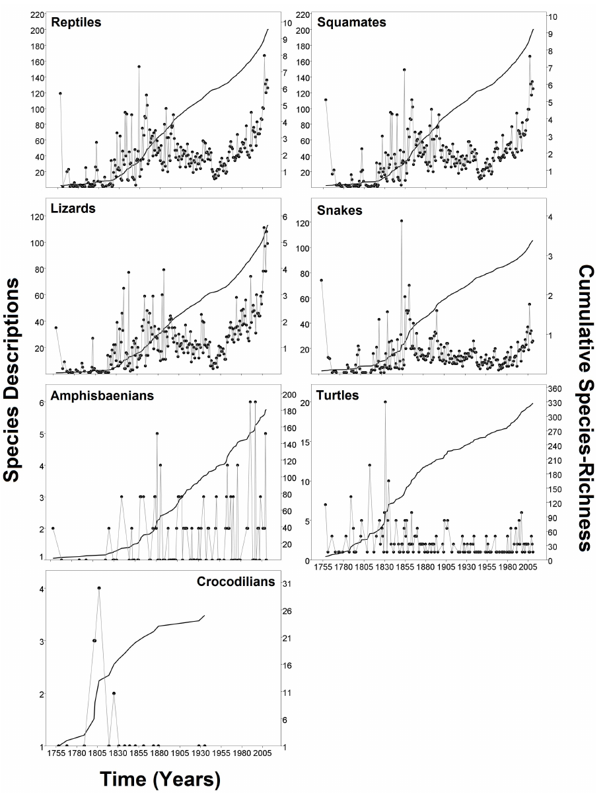
How do we know the total number of species?
Extrapolating species descriptions through time
Pincheira and Donoso (2013) PlosONE
Notes:
In this panel we can probably all agree that biodiversity is one of the most valuable natural resources.
But things like climate change or habitat loss are a threat to biodiversity, to the extent that we hear about biodiversity crisis, or sixth mass extinction
For example, about 1% of vertebrate species have gone extinct because of humans

Slide 24
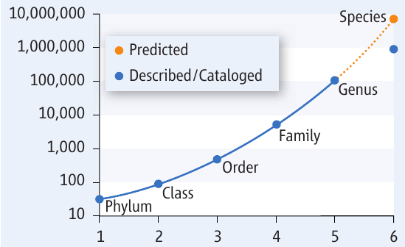
How do we know the total number of species?
Extrapolating numbers of species per higher taxonomic units
Strain (2011) Science
Notes:
In this panel we can probably all agree that biodiversity is one of the most valuable natural resources.
But things like climate change or habitat loss are a threat to biodiversity, to the extent that we hear about biodiversity crisis, or sixth mass extinction
For example, about 1% of vertebrate species have gone extinct because of humans

Slide 25
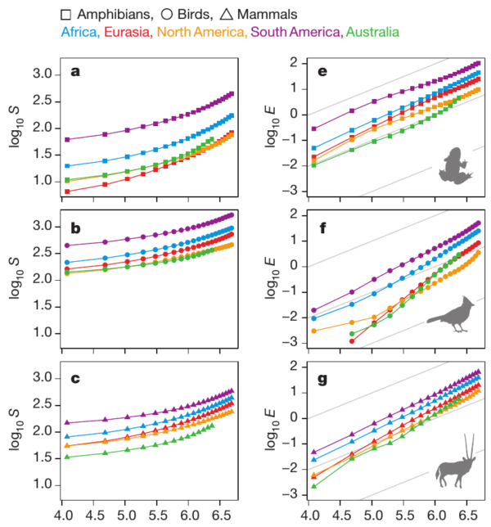
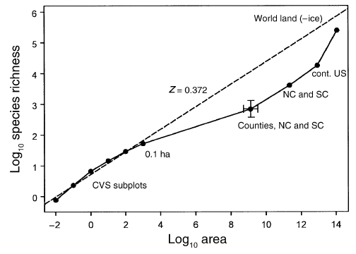
How do we know the total number of species?
Extrapolating species-area relationship
Fridley (2005) Ecology
Storch et al. (2012) Nature
Notes:
In this panel we can probably all agree that biodiversity is one of the most valuable natural resources.
But things like climate change or habitat loss are a threat to biodiversity, to the extent that we hear about biodiversity crisis, or sixth mass extinction
For example, about 1% of vertebrate species have gone extinct because of humans

Slide 26
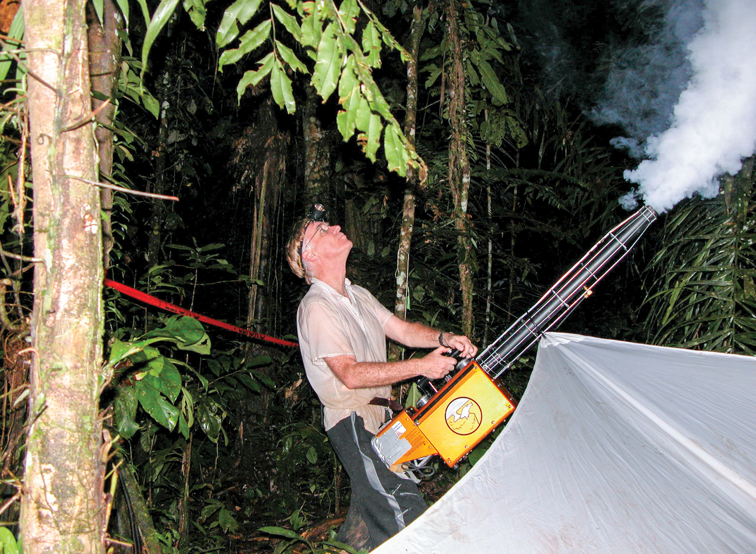
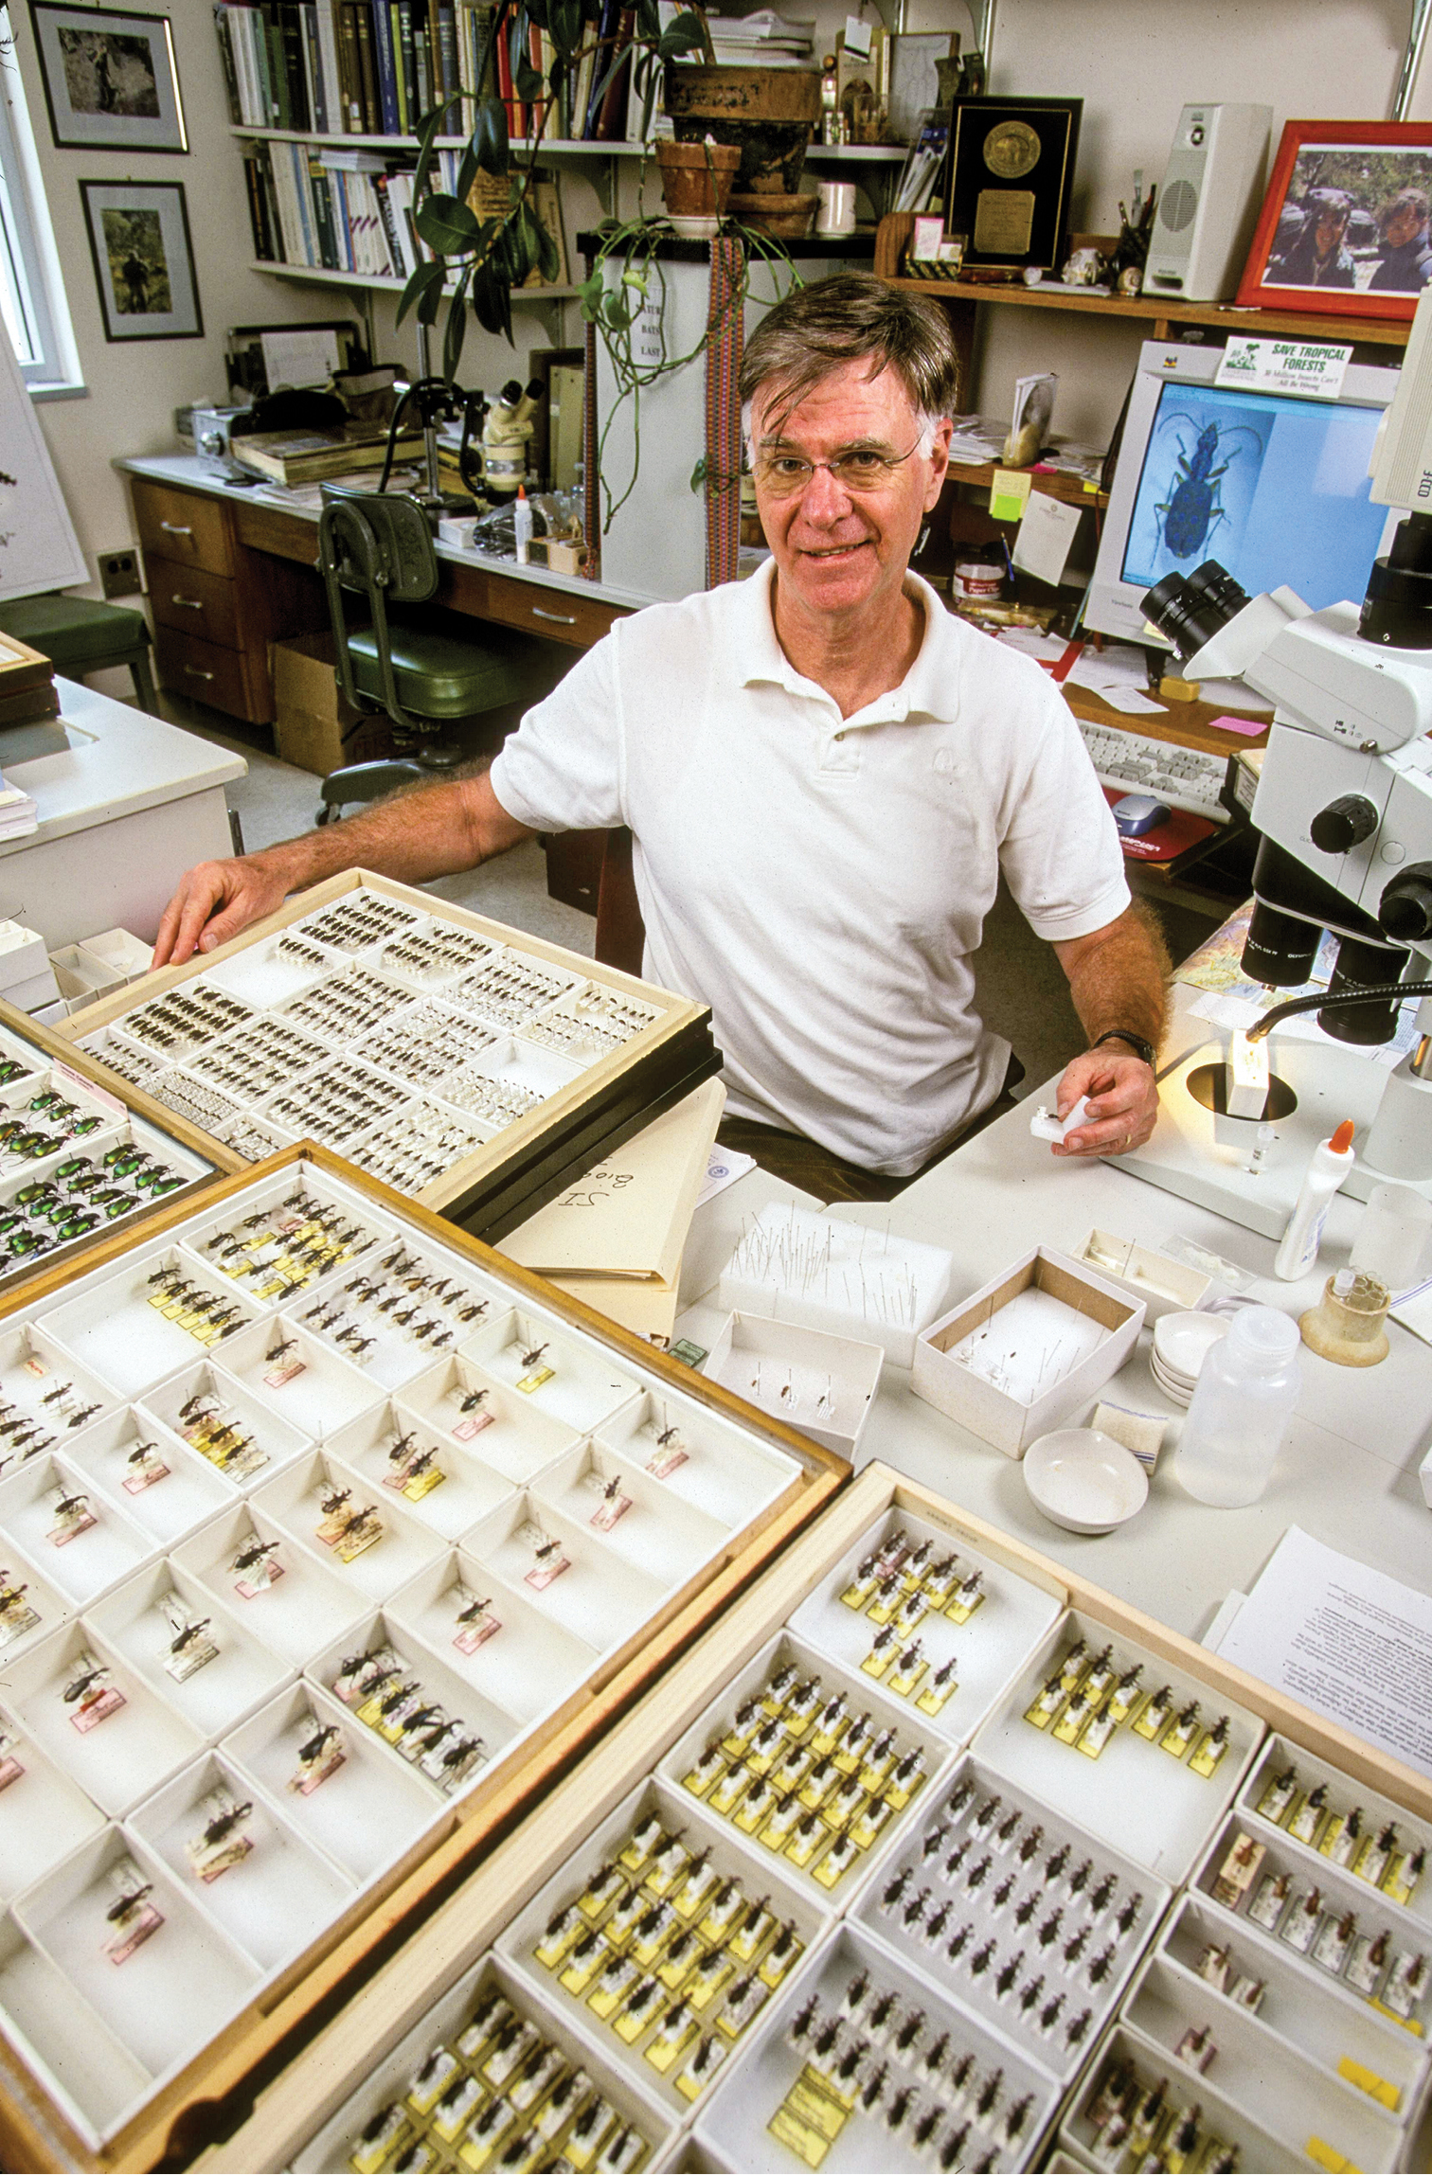
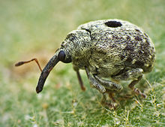
Terry Erwin: 30 million insect species
The 30 million estimate is based on the evaluation of host specificity of guilds in beetle samples, and subsequent hierarchical ratio extrapolations.
Curculionidae
Terry Erwin, 1971
Notes:
In this panel we can probably all agree that biodiversity is one of the most valuable natural resources.
But things like climate change or habitat loss are a threat to biodiversity, to the extent that we hear about biodiversity crisis, or sixth mass extinction
For example, about 1% of vertebrate species have gone extinct because of humans

Slide 27
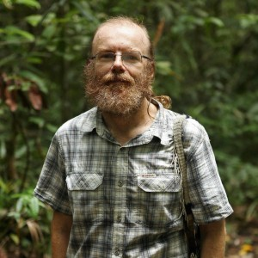
Novotny: Low host specificity of herbivorous insects
Vojtech Novotný
Novotny et al. (2007) Nature
Notes:
In this panel we can probably all agree that biodiversity is one of the most valuable natural resources.
But things like climate change or habitat loss are a threat to biodiversity, to the extent that we hear about biodiversity crisis, or sixth mass extinction
For example, about 1% of vertebrate species have gone extinct because of humans

Slide 28
Novotny: Low host specificity of herbivorous insects
Vojtech Novotný
Novotny et al. (2007) Nature
Notes:
In this panel we can probably all agree that biodiversity is one of the most valuable natural resources.
But things like climate change or habitat loss are a threat to biodiversity, to the extent that we hear about biodiversity crisis, or sixth mass extinction
For example, about 1% of vertebrate species have gone extinct because of humans

Slide 29
How is biodiversity distributed among organisms
Díaz & Malhi (2022) Annu. Rev. Environ. Res.
Notes:
In this panel we can probably all agree that biodiversity is one of the most valuable natural resources.
But things like climate change or habitat loss are a threat to biodiversity, to the extent that we hear about biodiversity crisis, or sixth mass extinction
For example, about 1% of vertebrate species have gone extinct because of humans

Slide 30
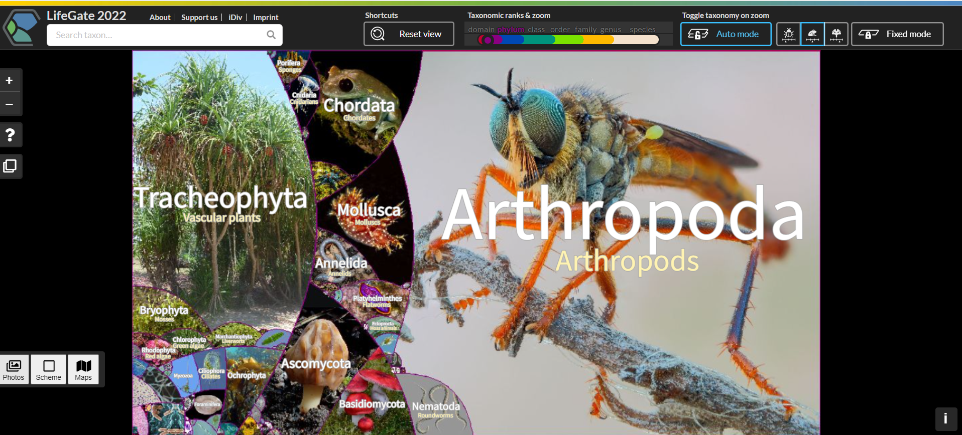
How is biodiversity distributed among organisms
https://lifegate.idiv.de/
Notes:
In this panel we can probably all agree that biodiversity is one of the most valuable natural resources.
But things like climate change or habitat loss are a threat to biodiversity, to the extent that we hear about biodiversity crisis, or sixth mass extinction
For example, about 1% of vertebrate species have gone extinct because of humans

Slide 31
The discrepancy among species diversity, phylogenetic diversity, and biomass
Díaz & Malhi (2022) Annu. Rev. Environ. Res.
Notes:
In this panel we can probably all agree that biodiversity is one of the most valuable natural resources.
But things like climate change or habitat loss are a threat to biodiversity, to the extent that we hear about biodiversity crisis, or sixth mass extinction
For example, about 1% of vertebrate species have gone extinct because of humans

Slide 32
Seas are dominated by bacteria, archea, and animals. Mainland by plants.
Includes
Diatoms
Includes
Cyanobacteria
Most biomass is terrestrial!
Díaz & Malhi (2022) Annu. Rev. Environ. Res.
Notes:
In this panel we can probably all agree that biodiversity is one of the most valuable natural resources.
But things like climate change or habitat loss are a threat to biodiversity, to the extent that we hear about biodiversity crisis, or sixth mass extinction
For example, about 1% of vertebrate species have gone extinct because of humans

Slide 33
Thank you. Questions?

Slide 34
Altitudinal gradients
From the sea towards the mountain tops
Notes:
I am qualified to deliver all this

Slide 35
Elevational gradient of species richness
Rahbek (1995) Ecography
Notes:
In this panel we can probably all agree that biodiversity is one of the most valuable natural resources.
But things like climate change or habitat loss are a threat to biodiversity, to the extent that we hear about biodiversity crisis, or sixth mass extinction
For example, about 1% of vertebrate species have gone extinct because of humans

Slide 36
Elevational gradient of species richness
Quintero & Jetz (2018) Nature
Notes:
In this panel we can probably all agree that biodiversity is one of the most valuable natural resources.
But things like climate change or habitat loss are a threat to biodiversity, to the extent that we hear about biodiversity crisis, or sixth mass extinction
For example, about 1% of vertebrate species have gone extinct because of humans

Slide 37
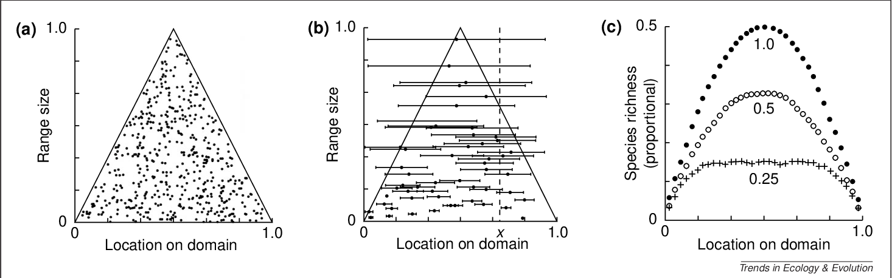
The mid domain effect
Notes:
In this panel we can probably all agree that biodiversity is one of the most valuable natural resources.
But things like climate change or habitat loss are a threat to biodiversity, to the extent that we hear about biodiversity crisis, or sixth mass extinction
For example, about 1% of vertebrate species have gone extinct because of humans

Slide 38
Latitudinal gradients
From the tropics towards the poles
Notes:
I am qualified to deliver all this

Slide 39
Latitudinal gradient
Birds across the New World (grid cells of ~ 611,000 km²)
Storch & Gaston (2004) Basic and Applied Ecology
Notes:
In this panel we can probably all agree that biodiversity is one of the most valuable natural resources.
But things like climate change or habitat loss are a threat to biodiversity, to the extent that we hear about biodiversity crisis, or sixth mass extinction
For example, about 1% of vertebrate species have gone extinct because of humans

Slide 40
Inverted latitudinal gradients
Xx
xs
Notes:
In this panel we can probably all agree that biodiversity is one of the most valuable natural resources.
But things like climate change or habitat loss are a threat to biodiversity, to the extent that we hear about biodiversity crisis, or sixth mass extinction
For example, about 1% of vertebrate species have gone extinct because of humans

Slide 41
Distance decay of similarity
The first law of biogeography
Notes:
I am qualified to deliver all this

Slide 42
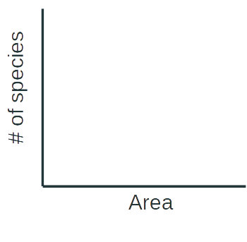

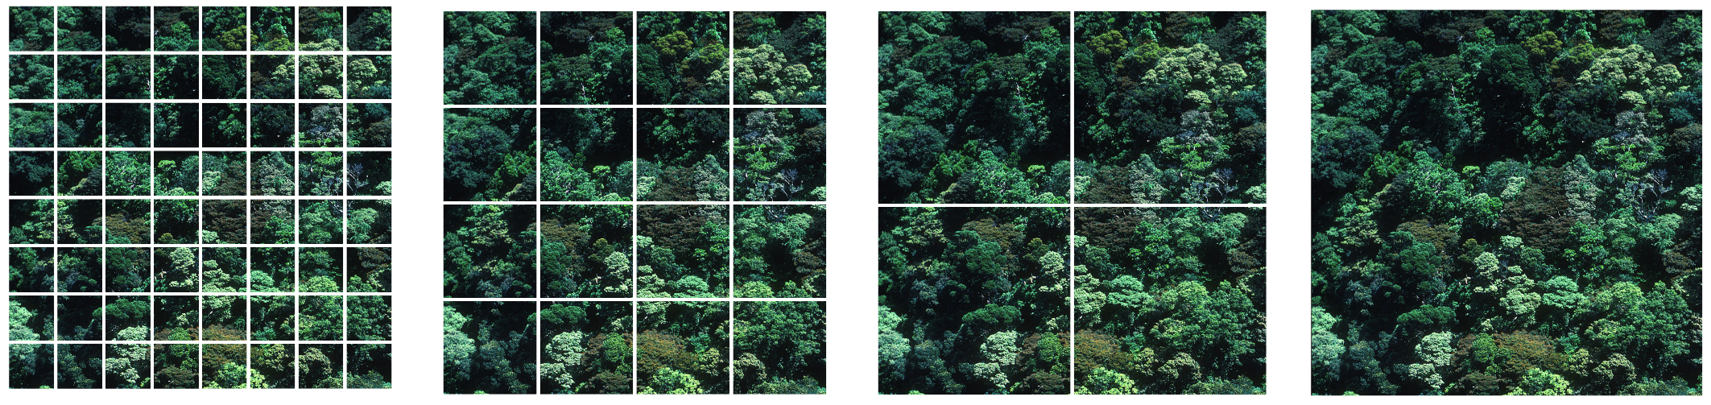
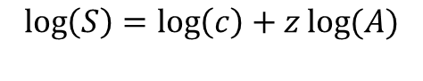
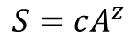
Species-area relationship: the basics
(S)
(S)
Power law (mocninná funkce)
$$S=cA^{z}$$
$$\log\left(S\right)=\log\left(c\right)+z\log{(A)}$$
log
(A)
log
(A)
Arrhenius (1921) Journal of Ecology
Notes:
In this panel we can probably all agree that biodiversity is one of the most valuable natural resources.
But things like climate change or habitat loss are a threat to biodiversity, to the extent that we hear about biodiversity crisis, or sixth mass extinction
For example, about 1% of vertebrate species have gone extinct because of humans

Slide 43
You should know
Xx
xs
Notes:
In this panel we can probably all agree that biodiversity is one of the most valuable natural resources.
But things like climate change or habitat loss are a threat to biodiversity, to the extent that we hear about biodiversity crisis, or sixth mass extinction
For example, about 1% of vertebrate species have gone extinct because of humans

